Slide 1
Connecting
All the units (processors, memory, I/O) must be connected
Computer is a network of basic modules.
Different type of connection for different type of unit
  Memory
  Input/Output
  CPU

Slide 2

Computer Modules

Slide 3
Memory Connection
Receives and sends data
Receives addresses (of locations)
Receives control signals
  Read
  Write
  Timing

Slide 4
Input/Output Connection(1)
Similar to memory from computer’s viewpoint
Output
  Receive data from computer
  Send data to peripheral
Input
  Receive data from peripheral
  Send data to computer

Slide 5
Input/Output Connection(2)
Receive control signals from computer
Send control signals to peripherals
  e.g. spin disk
Receive addresses from computer
  e.g. port number to identify peripheral
Send interrupt signals (control)

Slide 6
CPU Connection
Reads instruction and data
Writes out data (after processing)
Sends control signals to other units
Receives (& acts on) interrupts

Slide 7
Buses
There are a number of possible interconnection systems
Single and multiple BUS structures are most common
e.g. Control/Address/Data bus (PC)
e.g. Unibus (DEC-PDP)

Slide 8
What is a Bus?
A communication pathway connecting two or more devices
A signal transmitted by any one device is available for reception by all other devices attached to the bus (Usually broadcast )
A Bus consist of multiple lines, each capable of transmitting signals representing binary 1 or 0
A sequence of bits can be transmitted across a single line.
Often grouped
  A number of lines or channels in one bus
  e.g. 32 bit data bus is 32 separate single bit channels

Slide 9
System bus
A bus that connects major computer components (processor, memory, I/O) is called a system bus.
Consist of about 50 to hundreds of separate lines, each line is assigned a particular function
The lines can be classified into three functional groups:
    Data lines (data bus)
    Address lines (Address bus)
    Control lines (Control bus)

Slide 10
Data Bus
Carries data
  Remember that there is no difference between “data” and “instruction” at this level
Width is a key determinant of performance
  8, 16, 32, 64 bit or more
  Determines how many bits can be transmitted at a time

Slide 11
Address bus
Identify the source or destination of data
e.g. CPU needs to read an instruction (or data) from a given location in memory
Bus width determines maximum memory capacity of system
  e.g. 8080 has 16 bit address bus giving 64k (2¹⁶k) address space
  Typically the higher order bits are to select a particular module on the bus and the lower order bits select a memory location or I/O port within the module.

Slide 12
Control Bus
Control the access to and the use of data and address lines; ensuring shared access by all components
Control and timing information
  Memory read/write signal
  Interrupt request
  Clock signals

Slide 13

Bus Interconnection Scheme

Slide 14
Identifying buses in computer system
What do buses look like?
  Parallel electrical conductors made of metal lines etched on circuit boards (printed circuit board)
  Ribbon cables
  Strip connectors on motherboards
    e.g. PCI
  Sets of wires
On chip bus connect the processor and cache memory
On board bus may connect the processor to main memory and other components
Other cables are used to connect peripheral and storage devices

Slide 15
Single Bus Problems
Lots of devices on one bus leads to:
  Propagation delays
    Long data paths mean that co-ordination of bus use can adversely affect performance
    If aggregate data transfer approaches bus capacity
    The problem can be countered by increasing the data rate (e.g. increasing the data bus from 32 to 64 bits) but the data rates generated by attached devices (graphics and video controllers, network interfaces) are rapidly growing
    This is a race that a single bus is ultimately destined to lose.
Most systems use multiple buses to overcome these problems

Slide 16

Traditional (ISA)
(with cache)

Slide 17
Traditional bus Architecture
The local bus connects the processor to a cache memory and that may support one or more local devices.
The cache memory controller connect the cache to the local bus and to a system bus
The main memory modules are attached to system bus.
An expansion bus interface buffers data transfer between the system bus and I/O controllers to support wide variety of I/O devices
Typical I/O devices attached to the expansion bus are: 10-Mbps LAN connection, WAN, SCSI bus to support disk drives and other peripherals, serial port to support printer or scanner

Slide 18
High Performance Bus

Slide 19
High performance architecture
Supports the higher and higher performance I/O devices.
Local bus connects the processor to the cache controller which in turn connected to a system bus that supports main memory
The cache controller connects to high speed bus
The high speed bus supports connections to fast Ethernet, video and graphics controller, SCSI and FireWire
Lower speed devices are supported off an expansion bus
Expansion bus interface buffers traffic between the expansion bus and high speed bus

Slide 20
Bus Types
Dedicated
  Separate data & address lines
Multiplexed
  Shared lines
  Address valid or data valid control line
  Advantage - fewer lines
  Disadvantages
    More complex control
    Ultimate performance

Slide 21
Bus Arbitration
More than one module controlling the bus
e.g. CPU and DMA controller
Only one module may control bus at one time
Arbitration may be centralized or distributed

Slide 22
Centralized Arbitration
Single hardware device controlling bus access
  Bus Controller
  Arbiter
May be part of CPU or separate

Slide 23
Distributed Arbitration
there is no central controller; rather, each module contains access control logic and the modules act together to share the bus
Each module may claim the bus
Control logic on all modules

Slide 24
Timing
Co-ordination of events on bus
Synchronous
  Events determined by clock signals
  Control Bus includes clock line
  A single 1-0 is a bus cycle
  All devices can read clock line
  Usually synchronization occurs on leading edge
  Usually a single cycle for an event

Slide 25
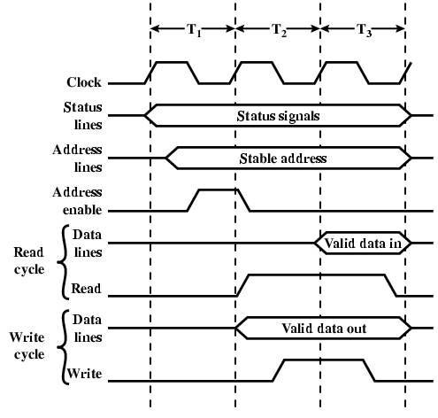
Synchronous Timing Diagram

Slide 26
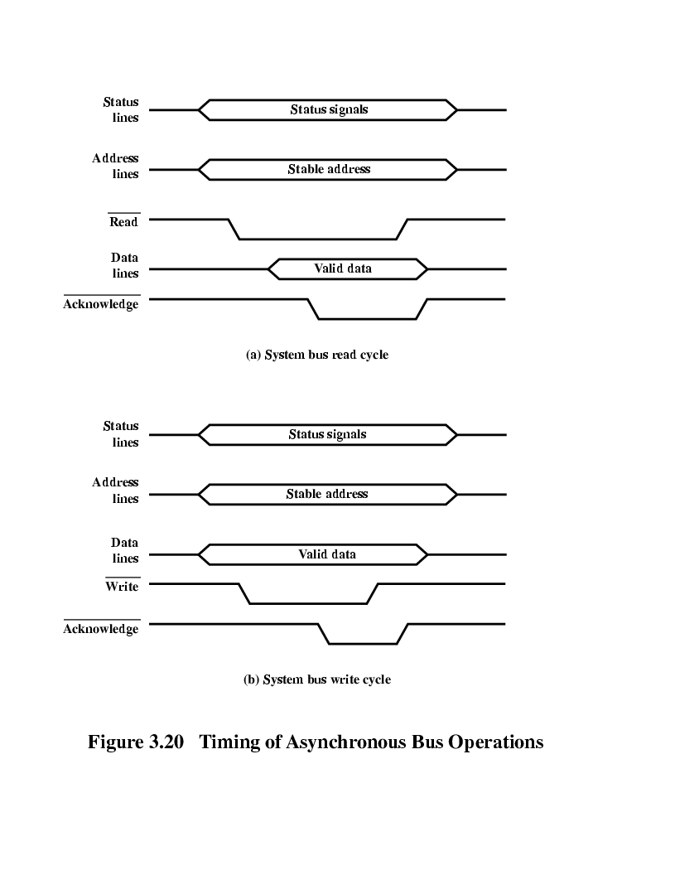
Asynchronous Timing – Read Diagram

Slide 27
Asynchronous Timing – Write Diagram

Slide 28
Synchronous and Asynchronous timing
Synchronous timing: The occurrence of events on the bus depend on the bus is determined by the clock
Asynchronous timing: The occurrence of one event on a bus follows and depends on the occurrence of a previous event

Slide 29
PCI
One of the most successful chip and board interconnect technologies in history.
PCI provided a tenfold performance gain over ISA, and its plug-and-play capabilities made it easier for users to add cards to their computers.
Developed initially for personal computer applications, PCI is used today in almost every computing platform.

Slide 30
PCI Bus
PCI=Peripheral Component Interconnection
Intel started to work on PCI in 1990 for its Pentium-based systems, and released to public domain after
32 or 64 bit bus
49 mandatory signal lines for PCI (table on pages 82, W. Stallings’s book), and 51 optional signal lines (table on pages 83, W. Stallings’s book )

Slide 31
PCI Bus Lines (required)
Systems lines
  Including clock and reset
Address & Data
  32 time mux lines for address/data
  Interrupt & validate lines
Interface Control
Arbitration
  Not shared
  Direct connection to PCI bus arbiter
Error lines

Slide 32
PCI Bus Lines (Optional)
Interrupt lines
  Not shared
Cache support
64-bit Bus Extension
  Additional 32 lines
  Time multiplexed
  2 lines to enable devices to agree to use 64-bit transfer
JTAG/Boundary Scan
  For testing procedures

Slide 33
PCI Commands
Transaction between initiator (master) and target
Master claims bus
Determine type of transaction
  e.g. I/O read/write
Address phase
One or more data phases

Slide 34
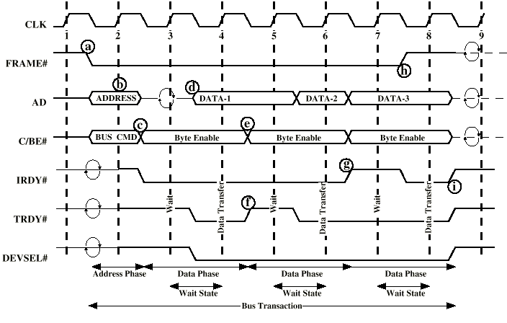
PCI Read Timing Diagram

Slide 35
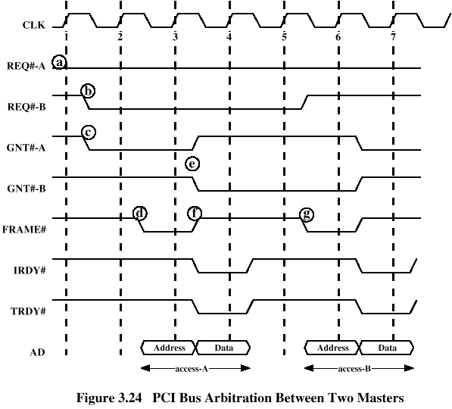
PCI Bus Arbitration

